Slide 1
Weather Condition Classification
Nakul Vadlamudi

Slide 2
Problem Statement
Objective:
Develop a predictive model that accurately classifies imminent weather conditions (Rain, Snow, Clear, Clouds) for proactive planning in various industries. This model will focus on a 5-day forecast with 3-hour intervals, covering approximately 900 US cities based on population size.
Challenges and Considerations:
- Data Quality and Consistency: Ensuring the Open Weather API data is reliable and consistent.
- Temporal Dynamics: Adapting to the fast-changing nature of weather conditions.
- Climatic Diversity: Addressing different weather patterns across diverse US cities.
- Model Optimization: Creating a model that is both accurate and computationally efficient.

Slide 3
Data Assumptions
Data Assumptions:
The data used for developing the model will be based on the 5-day forecasts provided by the Open Weather API's free plan. This data is expected to represent historical weather patterns, which will be instrumental in training the model.
For testing the model, weather data for the '6th day' will be utilized, operating under the assumption that it follows a continuous sequence from the 5-day forecast.

Slide 4
Hypotheses
Hypotheses:
Despite the inherent unpredictability of weather, it is hypothesized that the model will be able to accurately reflect short-term weather patterns based on the available historical data.
The predictive model is anticipated to deliver high-performance results in classifying four weather conditions: Rain, Snow, Clear, and Clouds. It is also expected to provide a user-friendly interface that offers detailed weather forecasts in 3-hour intervals for a single day, along with a historical overview of 5-day weather trends.
Through this model, significant weather trends across various regions and time periods will be uncovered, enhancing its potential application in fields such as public safety, agriculture, and general public use.

Slide 5
Methodology
User Application Dashboard
Phase 1
Data Collection
Phase 2a
Data Preprocessing
Phase 2b
Exploratory Data Analysis
Phase 3
Phase 2c
Predictive Analytics
1
2
3
4
5

Slide 6
Phase 1: Data Collection
The primary data source for this phase was the Open Weather API, a widely recognized provider of real-time and forecasted weather data. The free tier of this API was utilized, which provided forecast data for a 5-day period at 3-hour intervals.
Steps Undertaken:
API Access: Registered for Open Weather API and acquired an API key.
City Database: Compiled a list of 900 U.S. cities, ensuring geographic and climatic diversity.
Scripting for Data Retrieval: Developed a Python script for efficient data extraction and API interaction.
Data Transformation: Converted collected data from JSON to a structured tabular format.
Quality Checks: Performed data validation and integrity checks for consistency.
Problem Solving: Implemented a delay mechanism in the script to navigate API rate limits and ensure data uniformity.

Slide 7
Phase 2a: Data Preprocessing
The data preprocessing stage was crucial to prepare the raw data collected from the Open Weather API for detailed analysis and modelling. This step involved cleaning, transforming, and enriching the data to ensure it was accurate, consistent, and suitable for extracting meaningful insights.
Steps Undertaken:
Data Augmentation: Added additional data on population and density for the selected cities to enrich the dataset.
Data Cleaning: Streamlined the dataset by removing irrelevant columns and standardizing formats.
Feature Engineering: Developed new features, enhancing the dataset with elements like city tier and wind chill factors.
Data Profiling: Utilized Pandas Profiling for an in-depth analysis and profiling of the dataset.
Data Encoding and Scaling: Prepared the data for machine learning by applying encoding techniques to categorical data and normalizing numerical features.

Slide 8
Phase 2b: Exploratory Data Analysis
Tableau was employed to create dynamic and insightful visualizations of the weather data. This process was key in uncovering hidden patterns and relationships within the data, facilitating a deeper understanding of the various meteorological elements and their interdependencies.
Key Observations and Insights:
Southern U.S. regions exhibit warmer temperatures and milder wind chill effects, while northern areas have cooler temperatures and stronger wind chill, reflecting latitude-based climatic differences.
Coastal cities show higher precipitation and moderate temperatures, influenced by maritime effects that moderate temperature fluctuations and increase humidity.
Urban centers display higher temperatures, indicative of the urban heat island effect, where human activities elevate temperatures, particularly in densely populated areas.
The link between population density and precipitation varies, suggesting complex interactions among population density, regional climate, and topography in determining rainfall patterns.
Southern coastal areas experience less intense wind chill, likely due to oceanic influences stabilizing local temperatures and reducing wind chill effects.

Slide 9
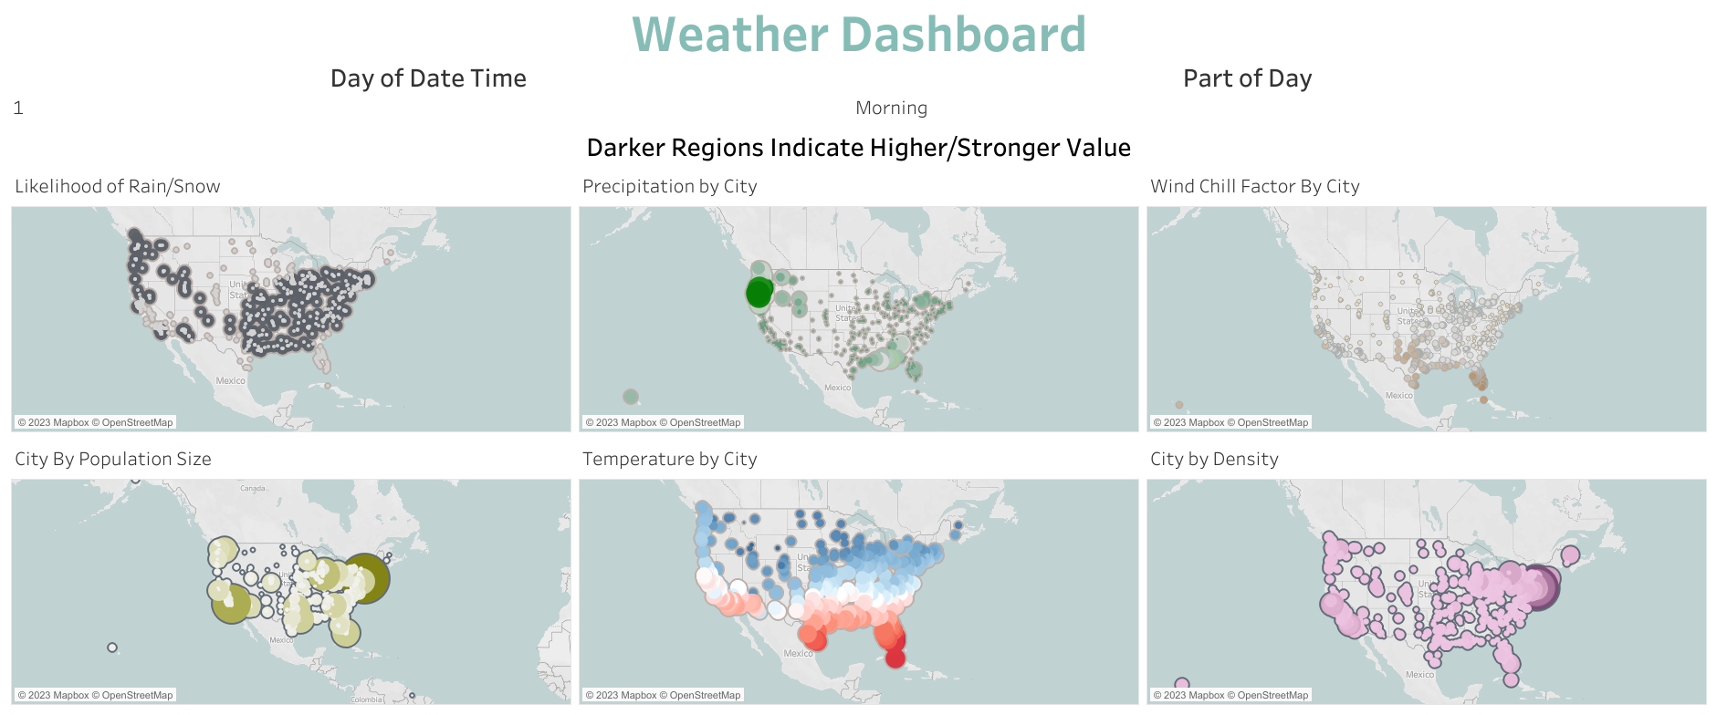
Tableau Data Visualization

Slide 10
Phase 2c: Predictive Analytics
In the predictive analytics phase, a series of machine learning models were developed and rigorously evaluated to classify weather conditions accurately. This step was essential in transforming the processed dataset into a practical forecasting tool, capable of providing valuable insights for various applications.
Proposed Approaches:
This exploration included Logistic Regression, Decision Tree Classifier, Gaussian Naive Bayes, K-Nearest Neighbors (KNN), Random Forest Classifier, Gradient Boosting Classifier, Extreme Gradient Boosting (XGBoost), and CatBoost Classifier.
An ensemble model combining Random Forest, XGBoost, and CatBoost was also developed to leverage the strengths of individual models.
Each model was trained on the preprocessed dataset and evaluated based on metrics such as F1-score and accuracy.

Slide 11
Key Findings
Model Name | f1-score on class 0 (Clear) | f1-score on class 1 (Clouds) | f1-score on class 2 (Rain) | f1-score on class 3 (Snow) | Train Accuracy | Test Accuracy
Random Forest | 0.998141 | 0.980718 | 0.879636 | 0.444444 | 1 | 0.965131
RandomForest + XGB + CatBoost | 0.998141 | 0.979958 | 0.868299 | 0.465753 | 0.999534 | 0.963352
Extreme Gradient Boosting | 0.998141 | 0.979525 | 0.867422 | 0.463768 | 0.999596 | 0.963174
Cat Boosting | 0.998141 | 0.978822 | 0.861148 | 0.459459 | 0.996056 | 0.961573

Slide 12
Phase 2c: Predictive Analytics
Model Selection
Train-Validation Evaluation:
The ensemble model of RandomForest, XGBoost, and CatBoost emerged as the top performer in the train-validation evaluation phase.
It achieved high F1-scores across all classes, particularly excelling in predicting 'Clear' and 'Clouds' weather conditions.
Train-Test Evaluation:
In the train-test evaluation, the Random Forest model demonstrated the highest test accuracy, closely followed by the ensemble model.
The Random Forest model also showed a perfect train accuracy of 1.0, indicating excellent performance on the training dataset.
Best Model: Ensemble (RandomForest + XGBoost + CatBoost )
Overall Accuracy was high but handled the class imbalance situation better than other models.
Weather Condition Classification

Slide 13
Phase 3: User Application Dashboard
A user-friendly interactive application dashboard was developed using Streamlit. This interactive platform was designed to enable users to explore and visualize weather forecasts easily. The dashboard serves as a practical tool, integrating the insights and predictive capabilities derived from the earlier phases of the project.
Features of Dashboard:
City Selection and Weather Data Display: Allows users to choose cities and view specific weather conditions, including temperature, humidity, and wind speed.
Interactive Charts and Graphs: Features interactive charts for visualizing various weather parameters and trends over time.
Weather Condition Icons: Integrates weather-specific icons for quick visual reference of forecasted conditions like snow, rain, clear sky, and clouds.
Forecast Date Selection: Provides an option for users to select a specific date to view the weather forecast.
Historical Weather Data Presentation: Displays historical weather data in an accessible format, enabling users to track past weather trends.

Slide 14
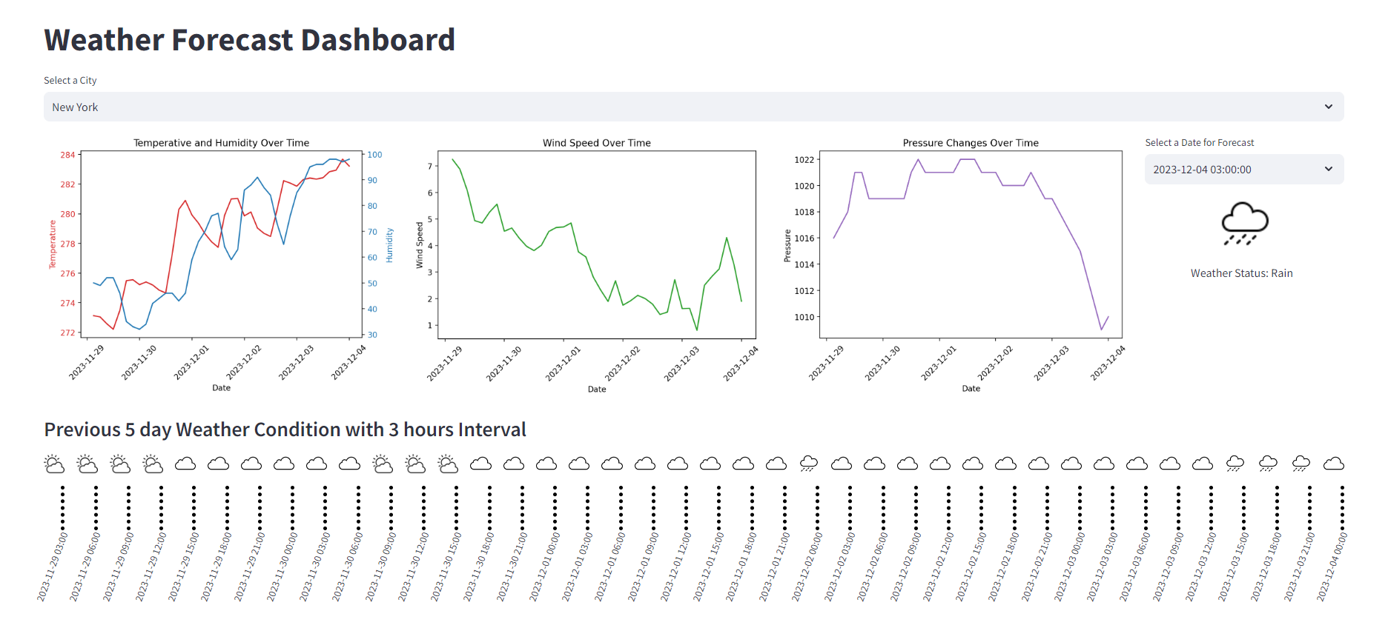
User Application Dashboard

Slide 15
Future Work
Model Improvement: Explore advanced machine learning techniques and more sophisticated models for potentially improved accuracy and efficiency.
Data Expansion: Consider incorporating additional data sources and expanding the geographical scope beyond the United States.
Real-Time Data Integration: Implement real-time data feeds for dynamic weather forecasting.
User Feedback Incorporation: Regularly update the application based on user feedback and evolving user needs.

Slide 16
GitHub Repo Link:
https://github.com/Nkv5810/Weather-Condition-Classification

